Slide 1

Automatically test your app on hundreds of real devices in the cloud
Notes:
Xamarin not only makes mobile development fast, easy and fun, we make it possible to test apps on hundreds of devices in the cloud.

Slide 2



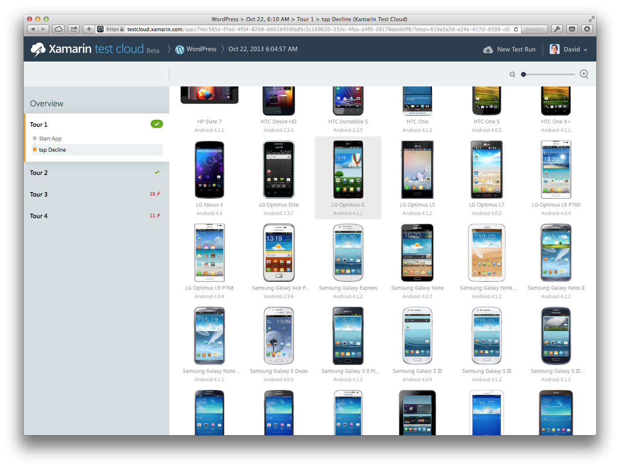
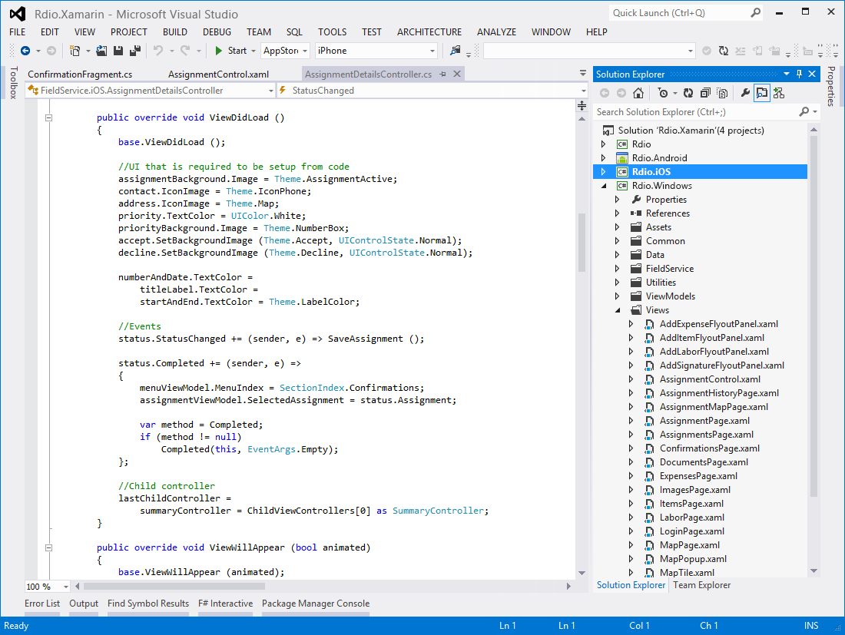
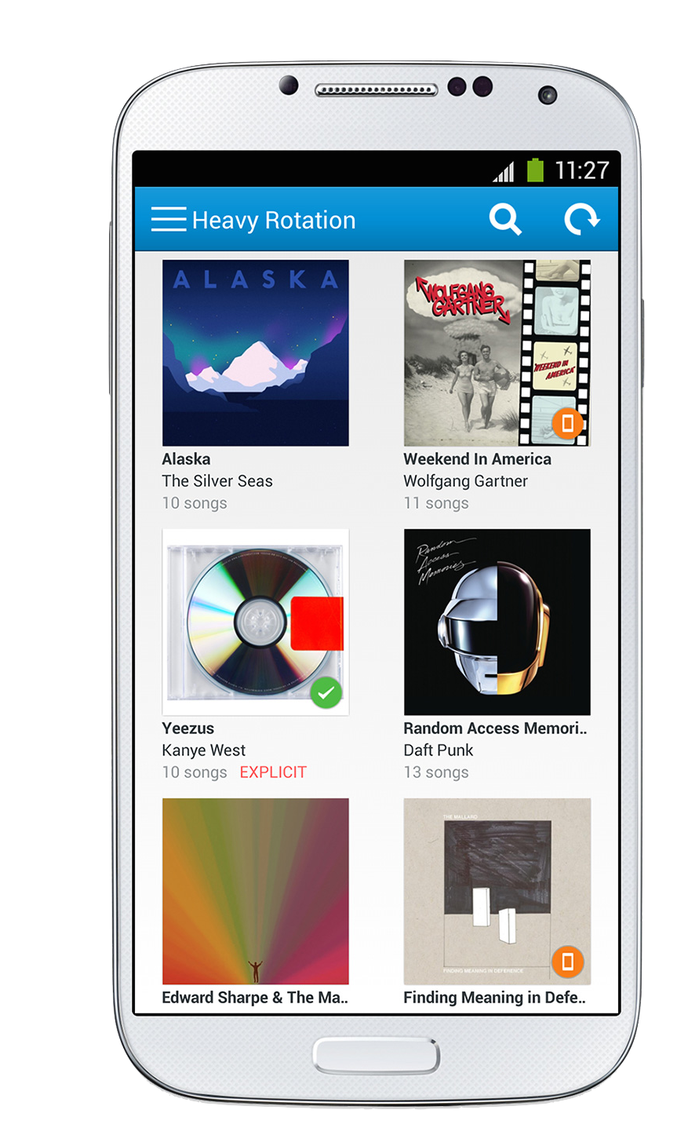
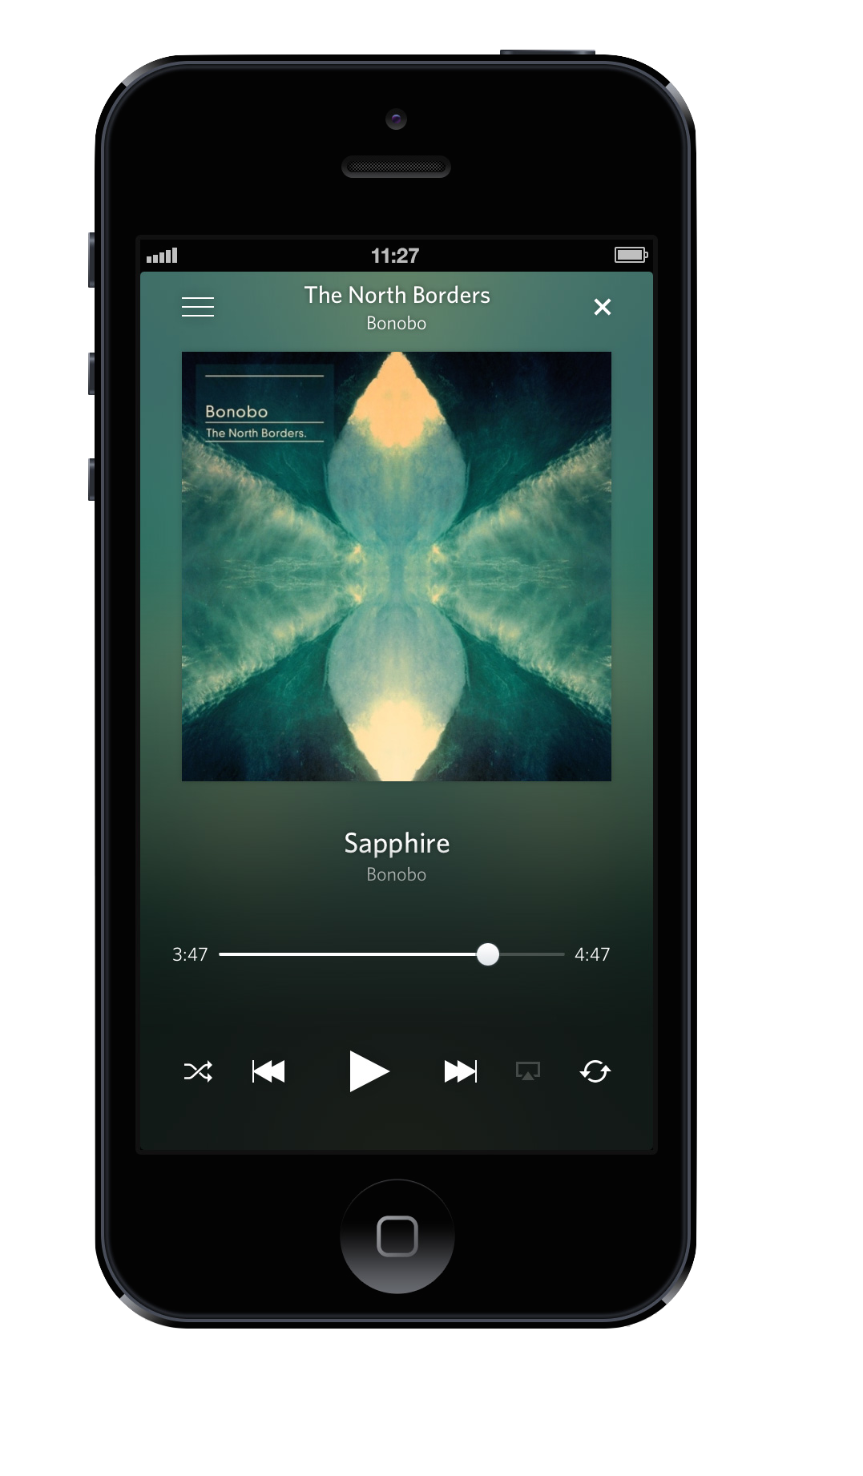
Native UI
C# + XAML
Create native iOS, Android, Mac and
Windows apps in Visual Studio and C#
Automatically test your app on
hundreds of mobile devices

Slide 3
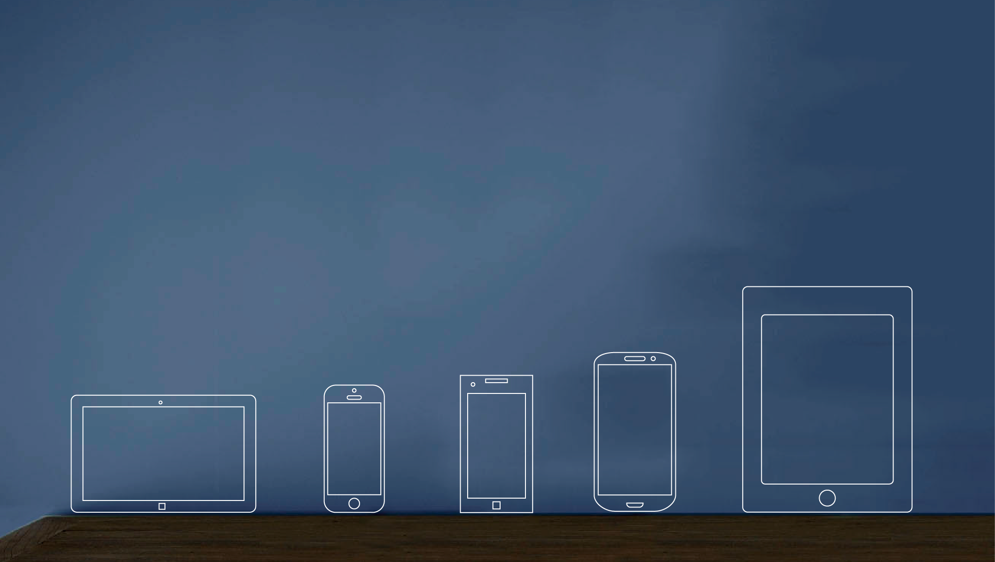
Xamarin: Explosive Growth in 3 Years
740,000
30,000
740,000 registered developers in just 3 years
150
Adding over 30,000 developers a month
10
Customers in
150 countries
In production use for 10 years

Slide 4
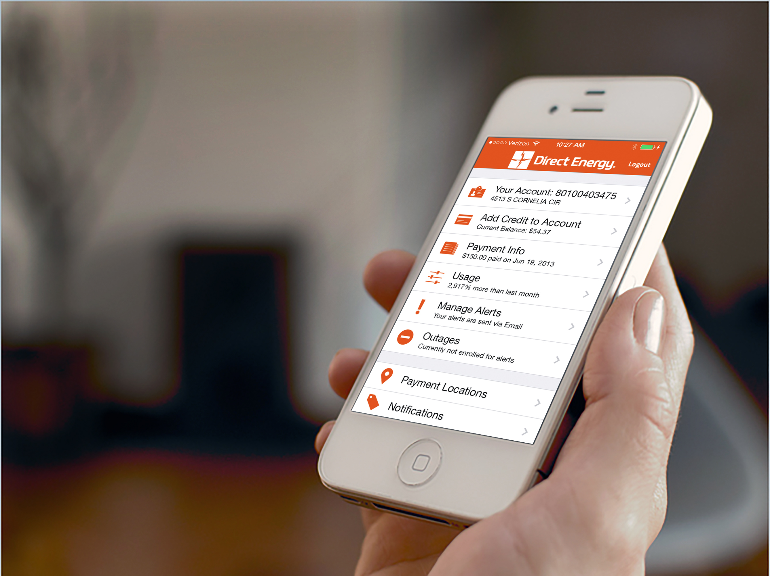
On Mobile, Quality Matters More.
Notes:
Delivering a fast, stable, native user experience matters more on mobile. Users are less error-tolerant in mobile use cases because they are inherently on-the-go. Whether you are mobilizing consumer interactions or business processes with employees, adoption depends on delivering a great app.

Slide 5




Crashes and regressions are the top causes of low app ratings
Ruth Cheshire May 15, 2014
Stopped working since update Have been using everyday for ages, great, no problems. Just updated says no connection on my Samsung Galaxy S3. Please fix.
Casey Cockfield October 19, 2013
Crashes Crashes on a new Samsung Mega
Manwell Casao December 4, 2013
Crashes on startup. Sony Xperia Z Ultra
Notes:
One of the biggest problems mobile end users encounter are app crashes and new bugs introduced in updates. While the rating systems in public app stores provide developers with some feedback, on the employee side, employees will just not use a bad app. All of this threatens the success of your mobile strategy.

Slide 6


U.S. Device Market Coverage Data
288
Companies must test on 134 devices to get to 75% U.S. market coverage
Number of Devices
134
45
13
0
Market Share
25%
50%
75%
90%
Notes:
And how do you know which devices matter to your users? This data illustrates exactly how challenging the device fragmentation problem is—with testing on 134 devices required to get 75% market coverage in the U.S. Many companies today still test on only a handful of devices, or invest millions in testing labs that have to keep up with a constantly changing device landscape.

Slide 7
For Your App To Be Successful You Need to Find
288
Number of Devices
134
45
13
0
Market Share
25%
50%
75%
90%
Notes:
And how do you know which devices matter to your users? This data illustrates exactly how challenging the device fragmentation problem is—with testing on 134 devices required to get 75% market coverage in the U.S. Many companies today still test on only a handful of devices, or invest millions in testing labs that have to keep up with a constantly changing device landscape.

Slide 8
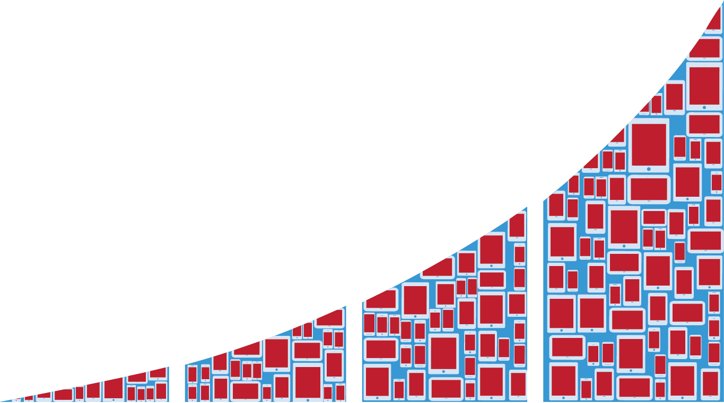
For Your App To Be Successful You Need to Find
288
Crashes and bugs that affect all devices
Number of Devices
134
45
13
0
Market Share
25%
50%
75%
90%
Notes:
And how do you know which devices matter to your users? This data illustrates exactly how challenging the device fragmentation problem is—with testing on 134 devices required to get 75% market coverage in the U.S. Many companies today still test on only a handful of devices, or invest millions in testing labs that have to keep up with a constantly changing device landscape.

Slide 9
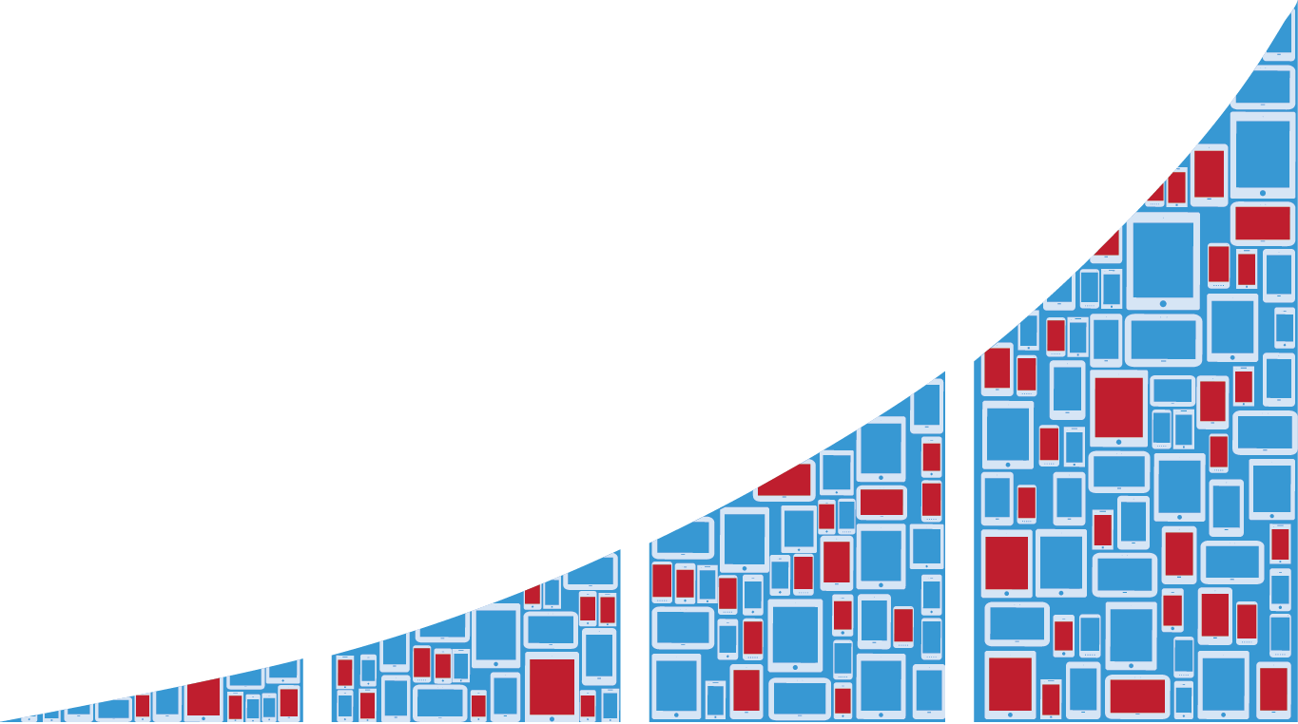
For Your App To Be Successful You Need to Find
288
Device-Specific issues (form factor, OS version, OEM-specific changes, hardware differences, resource limitations, …)
Number of Devices
134
45
13
0
Market Share
25%
50%
75%
90%
Notes:
And how do you know which devices matter to your users? This data illustrates exactly how challenging the device fragmentation problem is—with testing on 134 devices required to get 75% market coverage in the U.S. Many companies today still test on only a handful of devices, or invest millions in testing labs that have to keep up with a constantly changing device landscape.
HTC switched out entire networking stack to something proprietary,

Slide 10


A repeatable, fast way to consistently test your app on hundreds of real devices, exercising all app functionality.
Solution

Slide 11
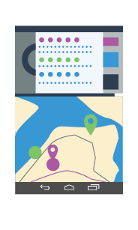
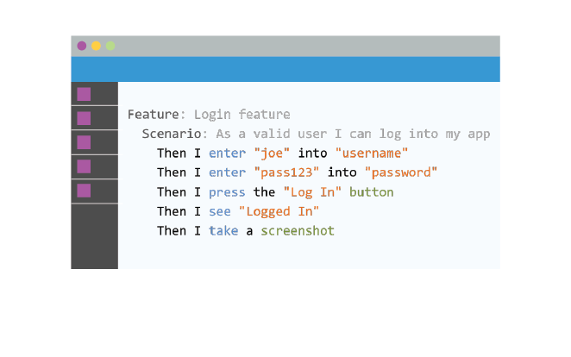
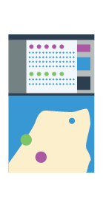
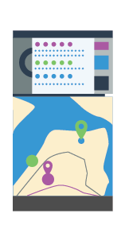
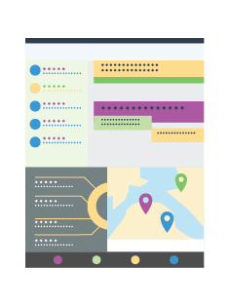
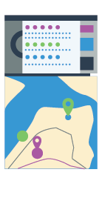
The End-to-End Mobile Quality Solution
Local UI Test Authoring
Create UI tests and run them locally on simulator or device.
Cloud Testing Lab
Over 1,000 real, non-jail broken devices available on-demand from the web UI or as part of your CI. Automatic performance monitoring and beautiful reports.

Slide 12

Automate Using Real Programming Languages
Ruby

Slide 13


Author Flexible Tests that Adapt to UI Changes
Object-level user interface testing
Tests adapt as user interface changes
Notes:
And how do you know which devices matter to your users? This data illustrates exactly how challenging the device fragmentation problem is—with testing on 134 devices required to get 75% market coverage in the U.S. Many companies today still test on only a handful of devices, or invest millions in testing labs that have to keep up with a constantly changing device landscape.

Slide 14

Jenkins
TFS
TeamCity
Incorporate Xamarin Test Cloud into continuous integration environments to shorten the feedback cycle and prevent users from finding regressions
Notes:
Xamarin Test Cloud is particularly powerful when integrated into Continuous Integration processes so that you can ensure that every release is a quality release.

Slide 15



Xamarin Test Cloud as a Managed Service
Xamarin Test Cloud executes the tests
You receive clear, actionable reports of your app on device
Xamarin authors tests
Give us your app and test use cases
1
2
3
4

Slide 16
Test Any Native or Hybrid App
Notes:
You can test any app with Xamarin Test Cloud, not just Xamarin apps.

Slide 17








Examples of User Interactions
Tap
Scroll
Swipe
Pinch
Multi finger
Text Entry
Rotation
GPS

Slide 18



Perform Geo-Specific Testing
Language
Currency
Network Condition
(coming soon)
Notes:
And how do you know which devices matter to your users? This data illustrates exactly how challenging the device fragmentation problem is—with testing on 134 devices required to get 75% market coverage in the U.S. Many companies today still test on only a handful of devices, or invest millions in testing labs that have to keep up with a constantly changing device landscape.

Slide 19
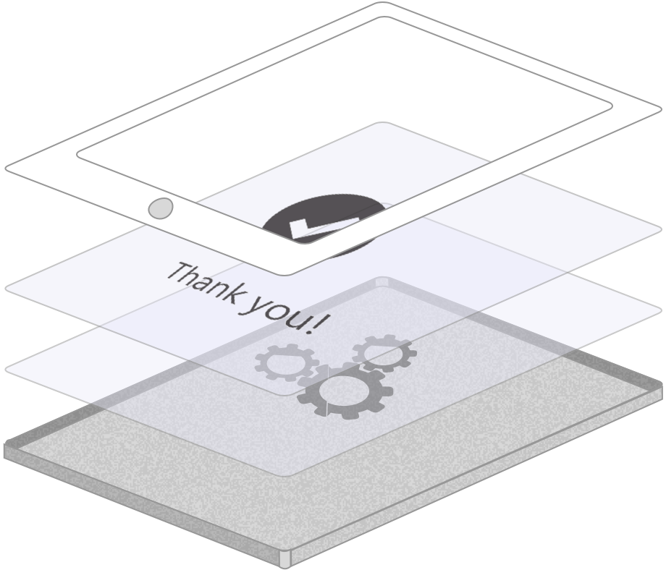



Make Assertions
Screen behavior
Internals of the app
Server interactions

Slide 20
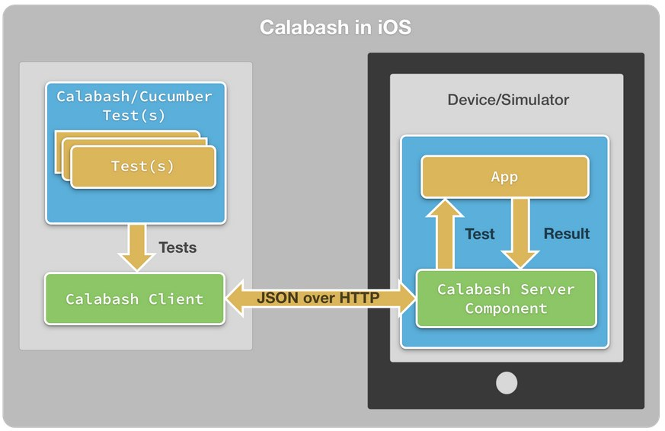
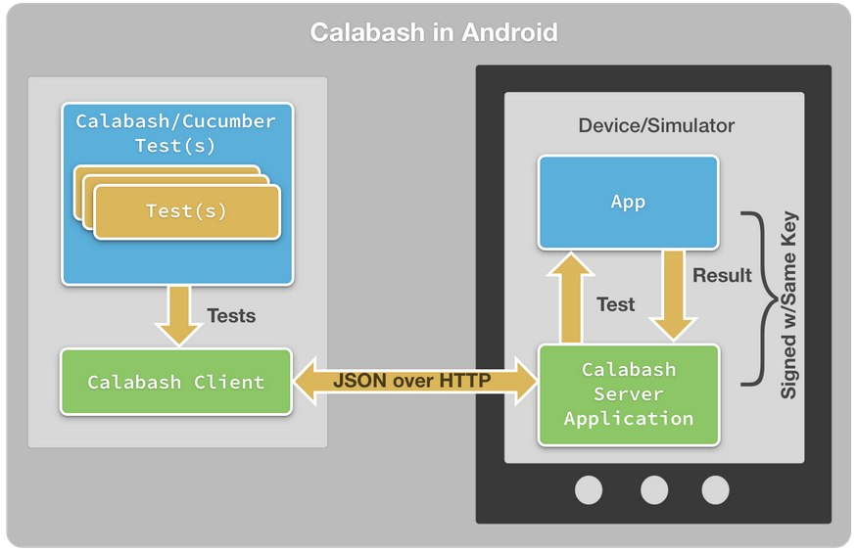


Client-Server Testing Architecture
Server is built into app to be tested via a component that is added via the Xamarin Component store
Server runs as a separate application, with permission to instrument application being tested
8
Notes:
Here’s a snapshot of how Xamarin Test Cloud works. <Need cking help>

Slide 21

Get Started Immediately
Quickstart Package with dedicated QA engineers provides:
Initial test authoring
Best practices guidance
Support to ensure your success
Notes:
Dedicated Xamarin QA engineers get you up and running with Xamarin Test Cloud quickly. Our Quick Start gives you access to expert mobile app automation engineers, who write your first tests and integrate Xamarin Test Cloud into your continuous integration system for you – so that you get value from day one and ensure your ongoing success.

Slide 22
DEMO

Slide 23



Customer Traction

Slide 24
“Xamarin Test Cloud is our path to a low maintenance, high quality and regression-free future. Not only is the product strikingly effective, but the team has been amazing — with their help we’ve seen immediate value from our investment. We’re excited about where this can take our team and product.”
Sean Beausoleil Mailbox Engineering Lead
Dropbox
Notes:
And how do you know which devices matter to your users? This data illustrates exactly how challenging the device fragmentation problem is—with testing on 134 devices required to get 75% market coverage in the U.S. Many companies today still test on only a handful of devices, or invest millions in testing labs that have to keep up with a constantly changing device landscape.

Slide 25

“As a QA Engineer, I am really enjoying the Xamarin Test Cloud because it offers me a broad range of Android and iOS devices, which gives me the ability to have more test coverage and to discover issues sooner. And what’s particularly helpful is that Xamarin offers exceptional service and support that I can depend on every day.”
Derrick Lam QA Engineer
Notes:
And how do you know which devices matter to your users? This data illustrates exactly how challenging the device fragmentation problem is—with testing on 134 devices required to get 75% market coverage in the U.S. Many companies today still test on only a handful of devices, or invest millions in testing labs that have to keep up with a constantly changing device landscape.

Slide 26

“Xamarin Test Cloud helped us identify and fix critical device-specific issues in the latest release of Foursquare before we released.”
Mike Singleton
Software Engineer

Slide 27

“Xamarin’s Calabash framework, and their Xamarin Test Cloud, plays a fundamental role in our continued effort to maintain the highest possible quality of our products and also in securing a short time-to-market.
Our test setup takes care of most of the tedious work doing regression tests and gives our team quick feedback, while helping us delivering new features at a fast predictive speed. Whenever we have encountered problems, the Xamarin service and support has been excellent.”
Niels Frydenholm, Software Architect at eBay Classifieds
Notes:
And how do you know which devices matter to your users? This data illustrates exactly how challenging the device fragmentation problem is—with testing on 134 devices required to get 75% market coverage in the U.S. Many companies today still test on only a handful of devices, or invest millions in testing labs that have to keep up with a constantly changing device landscape.

Slide 28

Xamarin Test Cloud has helped us catch important bugs in challenging scenarios, and to ensure they never occur again.”
Hamid Palo Android Team Lead
Notes:
And how do you know which devices matter to your users? This data illustrates exactly how challenging the device fragmentation problem is—with testing on 134 devices required to get 75% market coverage in the U.S. Many companies today still test on only a handful of devices, or invest millions in testing labs that have to keep up with a constantly changing device landscape.

Slide 29

“Xamarin Test Cloud helps us ensure that critical features of Expensify look and perform great on every Android device imaginable.”
Tom Jacobs
Software Engineer
Notes:
And how do you know which devices matter to your users? This data illustrates exactly how challenging the device fragmentation problem is—with testing on 134 devices required to get 75% market coverage in the U.S. Many companies today still test on only a handful of devices, or invest millions in testing labs that have to keep up with a constantly changing device landscape.

Slide 30
The End-to-End Mobile Quality Solution
Your people, your process, plus Xamarin Test Cloud.
Use as much of Xamarin Test Cloud as you like.
Flexible, generous, monthly usage-based plans
Write your own tests and plug in, or let our automation experts design & deliver a test suite
Run your tests on demand or integrated with your CI

Slide 31
Thank You

